Slide 1

DVD's Store
PRESENTED BY : NIKITA LAMSOGE

Slide 2
Analyzing DVD Rental Activity Over Time in Sakila Database
Welcome to our analysis of DVD rental activity over time using the Sakila DVD Store Database. We'll explore how DVD rentals have varied throughout different periods, providing insights that can aid decision-making and strategic planning for the store.

Slide 3
8 Most Important Questions
Q-1: How many DVDs are currently available for rent/sale?
Q-2: Which DVDs are currently checked out by customers?
Q-3: Who are the top 10 customers by rental frequency?
Q-4: What are the most popular movie genres among customers?
Q-5: How is the revenue distributed by film rating?
Q-6: Which actors have appeared in the most films?
Q-7: What is the total revenue earned for each month in the year 2005?
Q-8: How does DVD rental activity vary over time?

Slide 4

Q-1: How many DVDs are currently available for rent/sale?
183 DVD's are currently
Available for Rent/Sale.

Slide 5
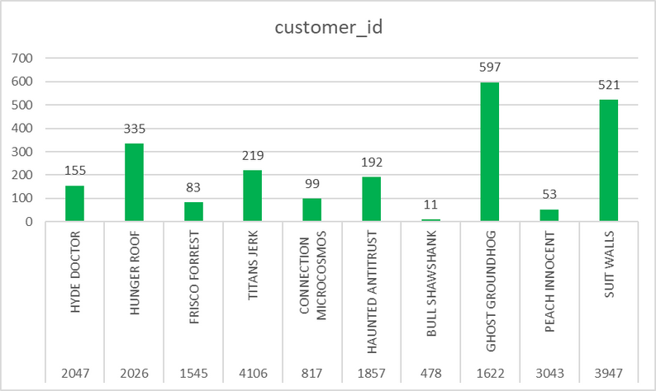
Q-2: Which DVDs are currently checked out by customers?
"The highest number of DVDs for the movie 'GHOST GROUNDHOG' is currently checked out by customers."

Slide 6
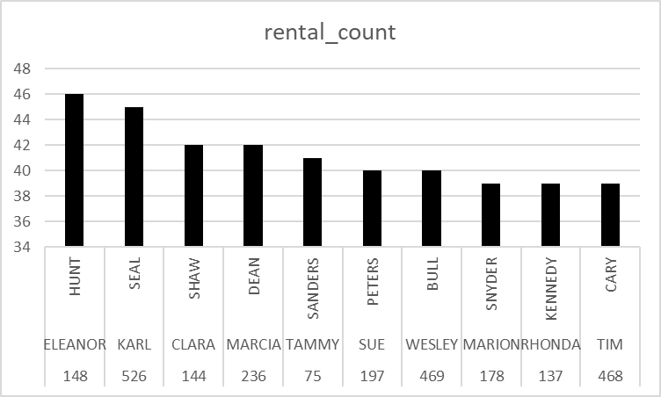
Q-3: Who are the top 10 customers by rental frequency?
"All of these are the top 10 customers who rent frequently, and among them, ELEANOR HUNT rents most frequently."

Slide 7
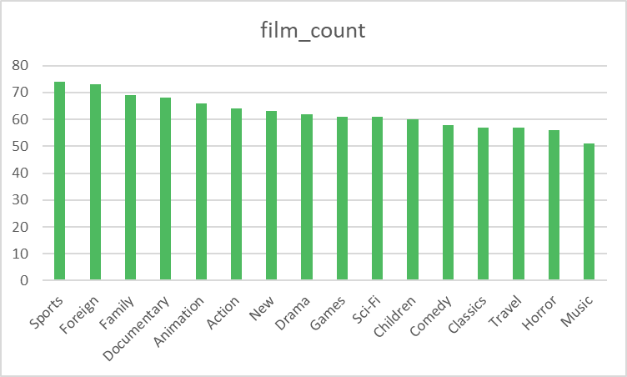
Q-4: What are the most popular movie genres among customers?
"These are the most popular movie genres among customers, with the sports genre having the highest count of 74."

Slide 8
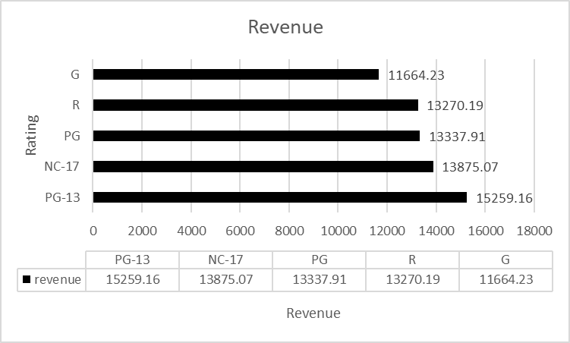
Q-5: How is the revenue distributed by film rating?
"The revenue is distributed according to the film ratings, with 'PG-13' having the highest revenue compared to others."

Slide 9
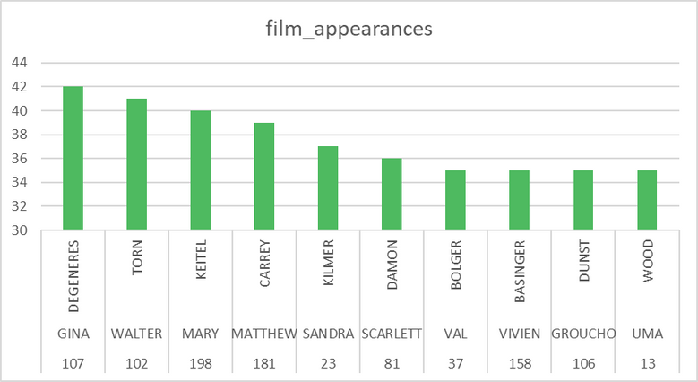
Q-6: Which actors have appeared in the most films?
"GINA DEGENERES "
has appeared in the most films.

Slide 10
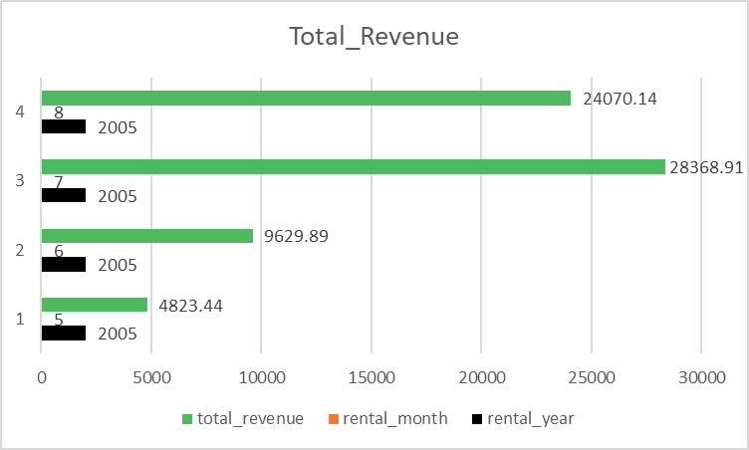
Q-7: What is the total revenue earned for each month in the year 2005?
The rental revenue data for 2005, emphasizing May to August. Revenue progressively rises, with July reaching the highest at 28,368.91. This aids in recognizing successful periods and strategizing for improved revenue.

Slide 11
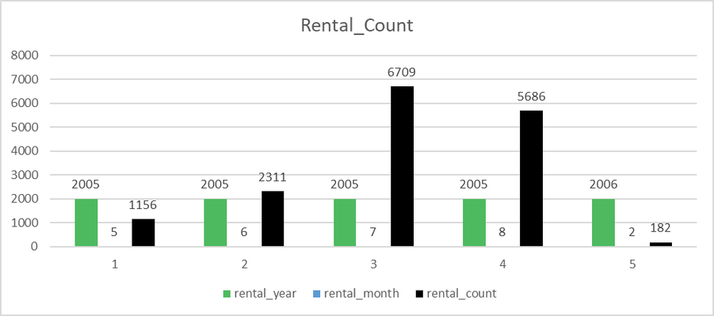
Q-8: How does DVD rental activity vary over time?
This data offers insights into fluctuations in rental demand,
helping the store allocate resources and plan promotions
effectively. In the rental year 2005, the month of July has
the highest rental count, which is 6709.

Slide 12

Thank You

